Slide 2
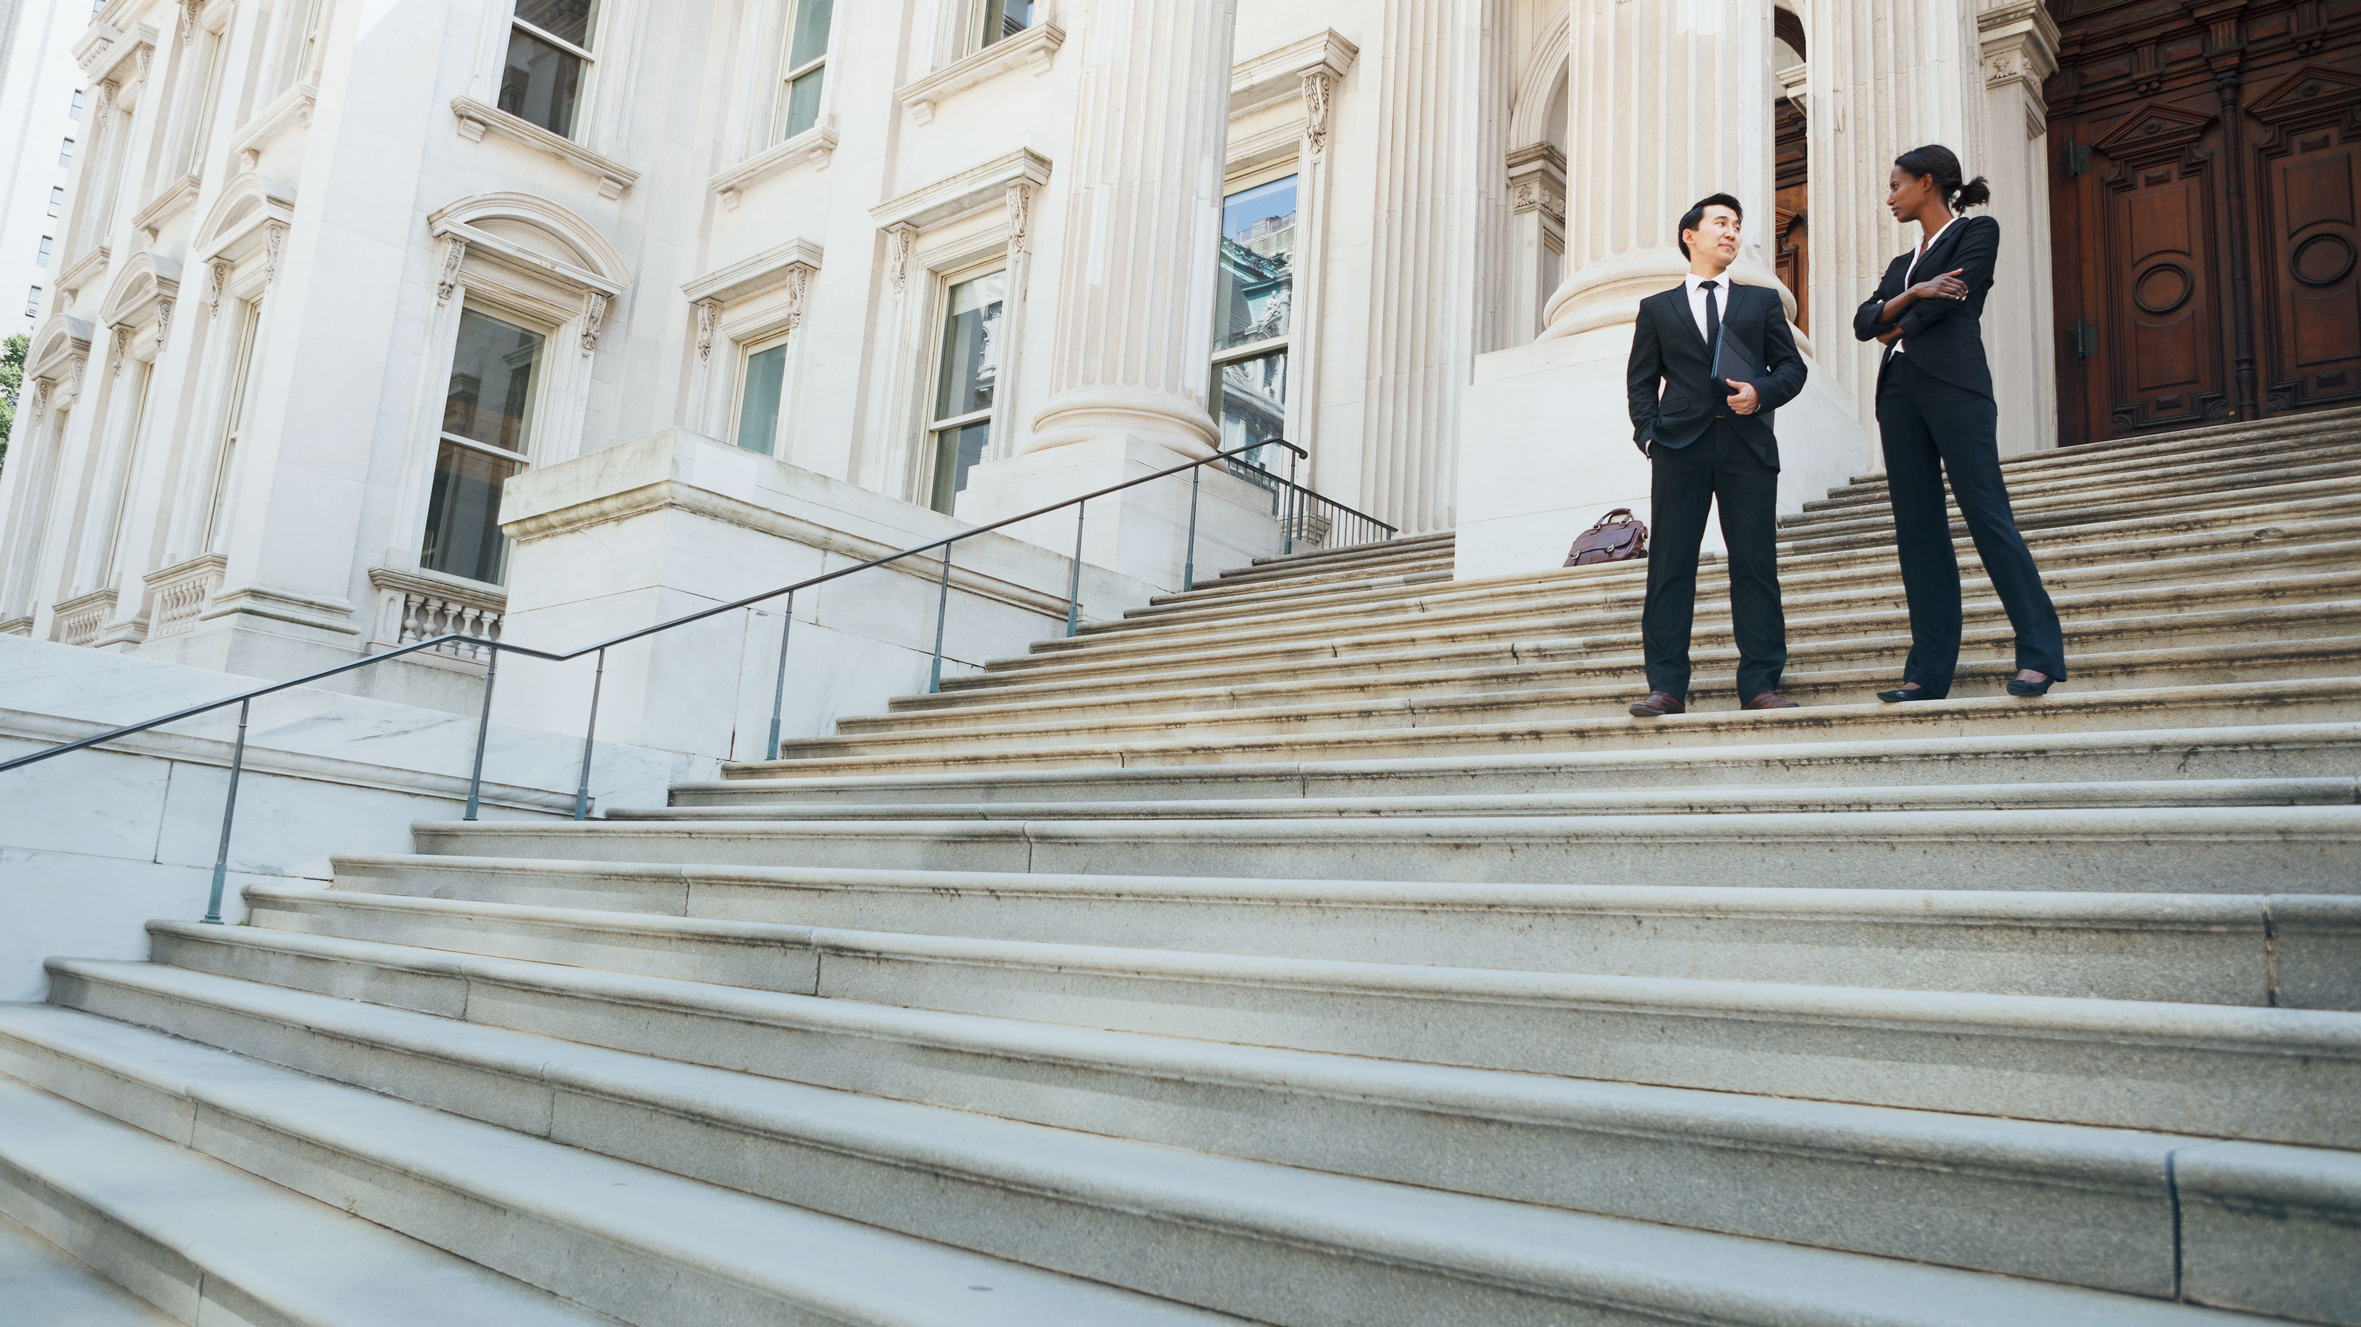
v
OUR MISSION
The mission of the ABOTA Foundation is to promote and improve the American civil justice system and to preserve the Seventh Amendment right to civil jury trials for future generations.
THE ABOTA FOUNDATION
WHO WE ARE

Slide 3
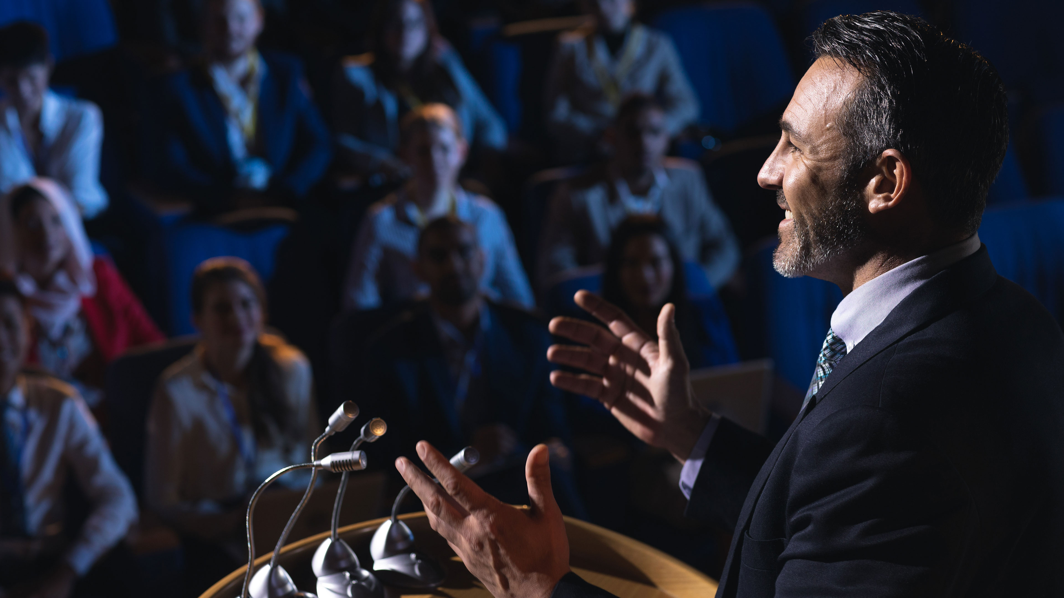
v
THE ABOTA FOUNDATION
WHAT WE DO
PROMOTE
Promote public appreciation and respect for the civil justice system and its role in upholding societal values in democracy.

Slide 4
v
THE ABOTA FOUNDATION
WHAT WE DO
ELEVATE
Elevate the importance and understanding, among our country’s youth, of the Seventh Amendment to our democracy and civil justice system.

Slide 5
v
THE ABOTA FOUNDATION
WHAT WE DO
EQUIP & INSPIRE
Equip and inspire lawyers and law students to serve as ethical, civil, and skilled advocates for the Seventh Amendment and our civil justice system.

Slide 9
v
v
1ST BASE
CIVICS EDUCATION
EDUCATION FOR STUDENTS
AT BAT (ABOTA Teaches: Balance, Advocacy & Tolerance) – Formerly the Civics Education Literacy Program
James Otis Lecture Series (JOL)
High School Civility Matters
Contact foundation@abota.org to
learn more or schedule a program.

Slide 10
v
v
1ST BASE
CIVICS EDUCATION
EDUCATION FOR TEACHERS
Teachers Law School (TLS)
Monthly Civics Resource Release
ABOTA Foundation Teaching Resources –
Visit: teacherspayteachers.com to view the Foundation's library of lesson plans
Contact foundation@abota.org to
learn more or schedule a program.

Slide 12
v
v
2ND BASE
PROFESSIONAL EDUCATION
EDUCATION FOR LAWYERS & LAW STUDENTS
Masters in Trial ™
Civility Matters ™
Chapter Driven CLE Programs
Monthly Webinar Series – Free to all in the legal community
ABOTA National Trial College – Coming next in Summer 2024!
Contact foundation@abota.org to
learn more or schedule a program.

Slide 13
v
v
2ND BASE
PROFESSIONAL EDUCATION
EDUCATION FOR LAWYERS & LAW STUDENTS
2023 - Special Presentations by the ABOTA Foundation
A More Perfect Jury: Seating a Fair and Diverse Panel – April 6, 2023
The Modern Jury Trial: The Effect of Today’s America on a “Jury of Your Peers” – October 5, 2023
Contact foundation@abota.org to
learn more or schedule a program.

Slide 15
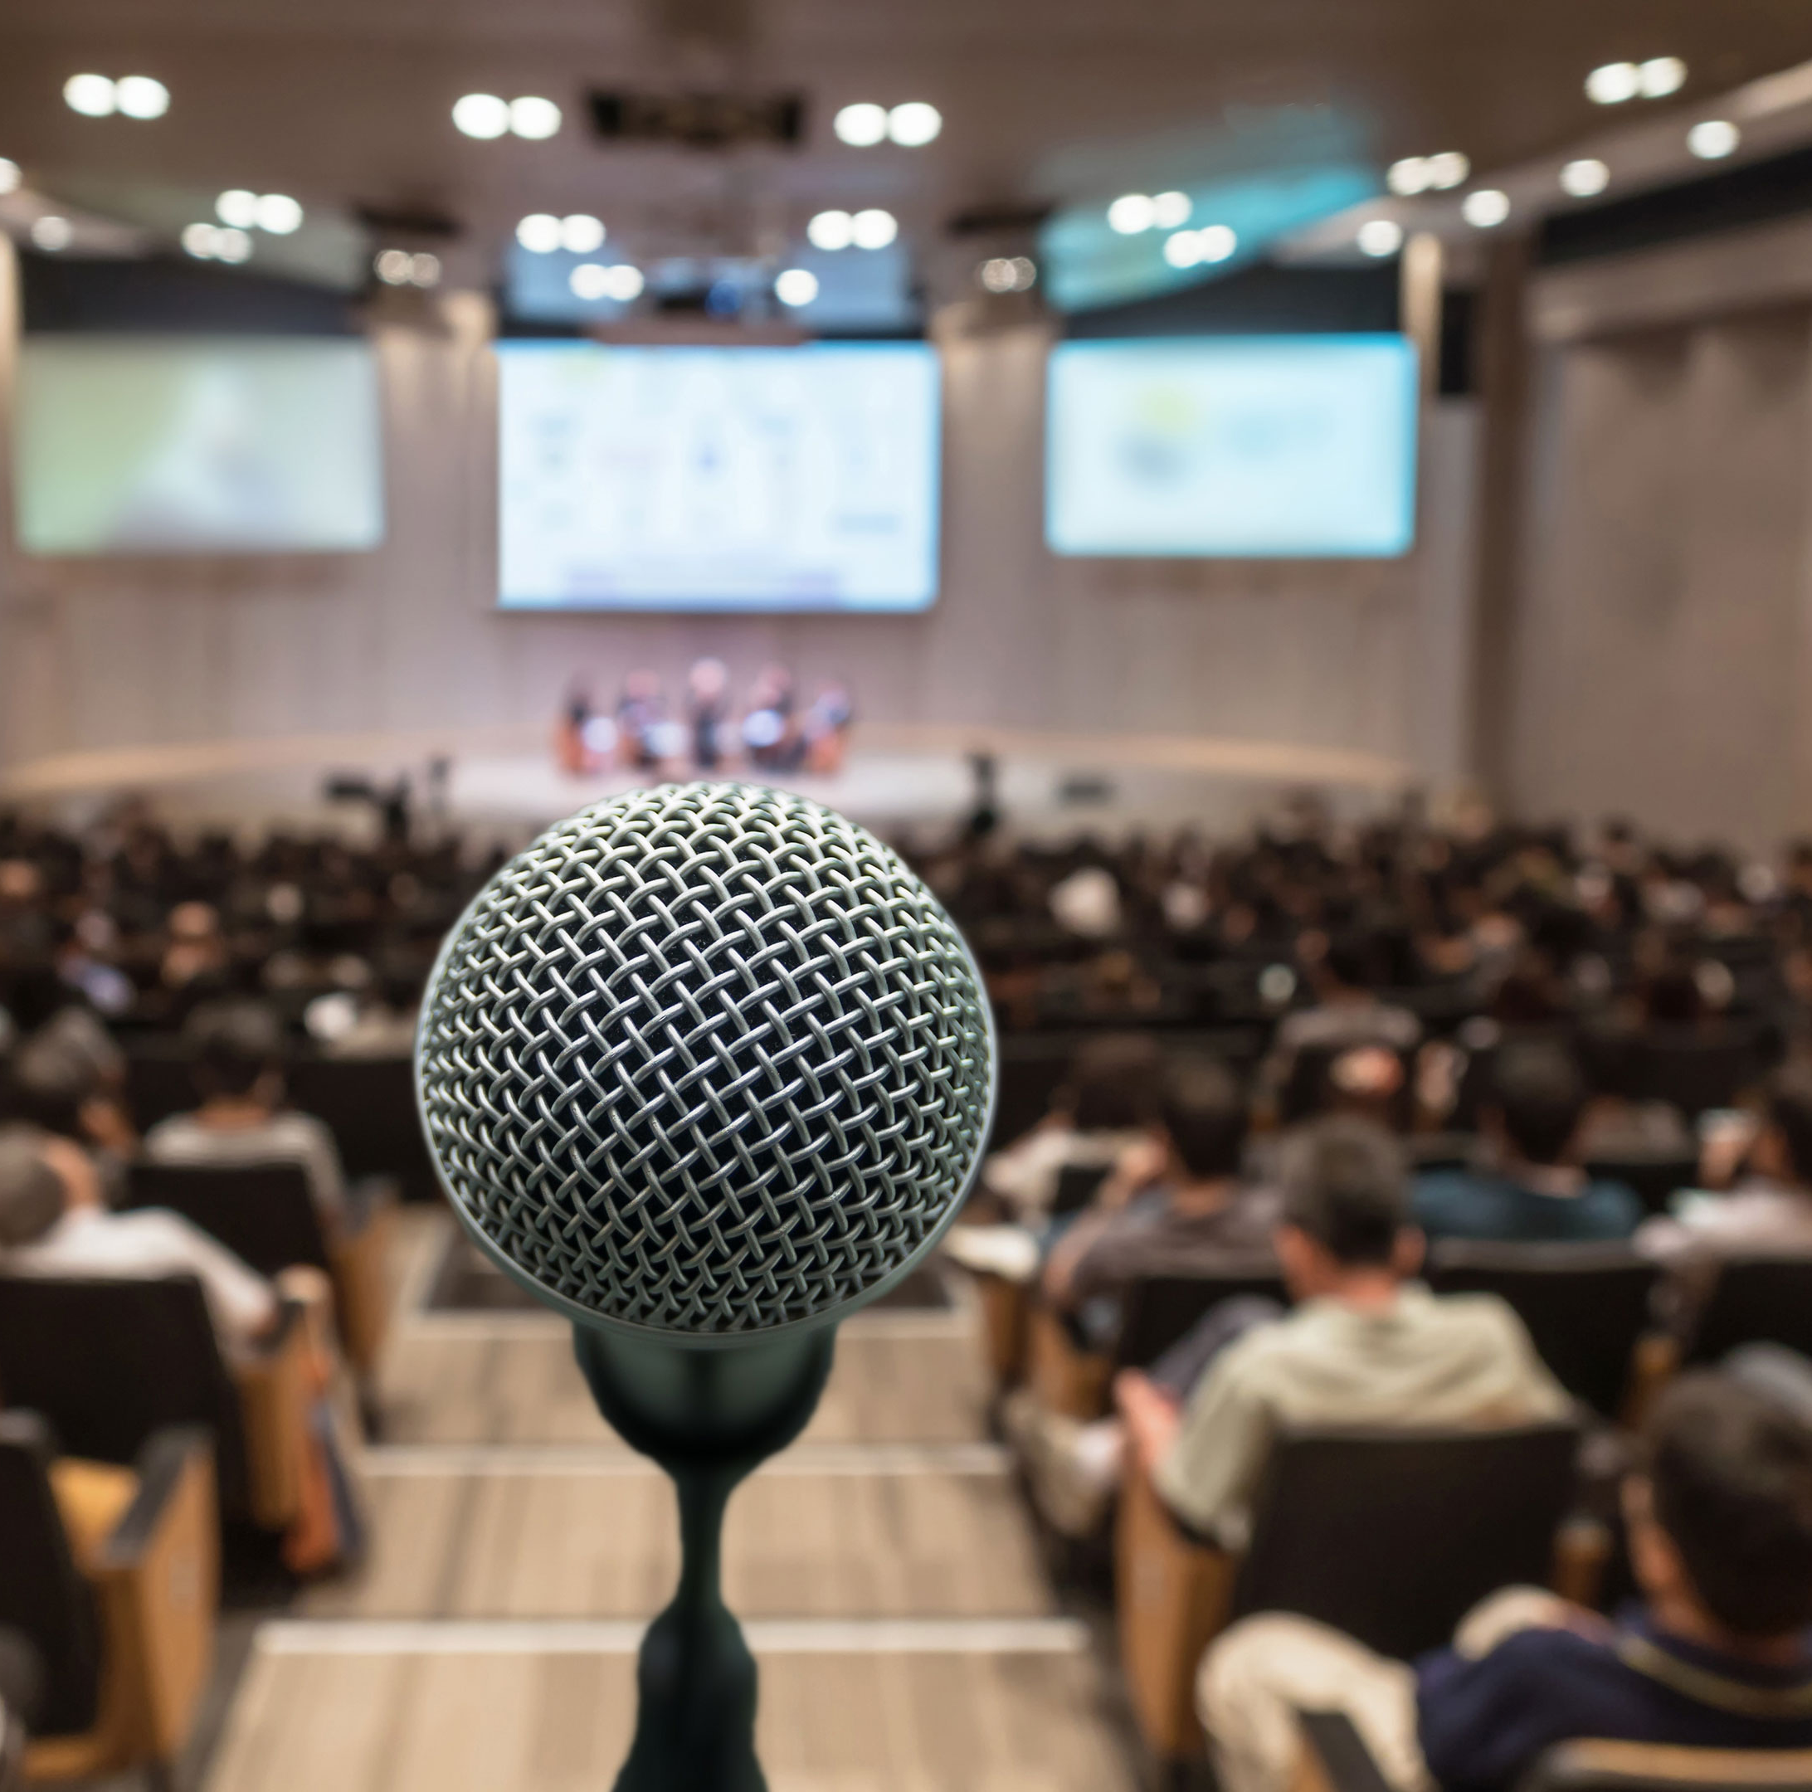
v
v
3RD BASE
PUBLIC AWARENESS
EDUCATING THE PUBLIC
Partnership with Save Our Juries
Partnership with the Center for Strategic and
International Studies (CSIS)
Juror Appreciation Efforts
Contact foundation@abota.org to
learn more or schedule a program.

Slide 18
v
THE FELLOWS PROGRAM
Foundation Fellows make an ongoing commitment to education and to the civil justice system by supporting the content and programming that we make available to all Americans.
THE ABOTA FOUNDATION
FELLOWS PROGRAM

Slide 19
v
THE ABOTA FOUNDATION
FELLOWS PROGRAM
BECOME A FELLOW
Make a donation of any amount to become a Fellow
Become a member of the Sustainers Society
Attorneys in Texas may choose to contribute through participation in the Guardian Ad Litem program
Contact foundation@abota.org to learn more.

Slide 20
Signer: $100,000 and above
THE ABOTA FOUNDATION
FELLOWS PROGRAM
Founder: $75,000 - $99,999
Delegate: $50,000 - $74,999
LEVEL UP AS YOU
GO!
Drafter: $35,000 - $49,999
Governor: $20,000 - $34,999
Ratifier: $10,000 - $19,999
Patriot: $5,000 - $9,999
Senior Life Fellow: $2,000 - $4,999
Life Fellow: $1,500 - $1,999
Fellow: Up to $1,500

Slide 21
v
THE ABOTA FOUNDATION
SUSTAINERS SOCIETY
Monthly contributions to the ABOTA Foundation to help us grow and sustain our programs and further our mission. Automatic payments are charged to your credit card for as little as $25/month.
Visit abota.org/foundation and click donate to sign up for monthly giving

Slide 22
THE ABOTA FOUNDATION
SUSTAINERS SOCIETY
v
Join our current Sustainers in supporting the Foundation!
Robert C. Alden
Christopher J. Beeman
Christine O. Boyd
Rayma Church
R. Scott Costantino
Douglas M. DeGrave
Jennifer Haltom Doan
Gary Dordick
Andrea La'Verne Edney
Hon. Bryan Foster
Dana Fox
Kathleen Gallagher
Gregory Gowan
Stephen C. Grebing
Dennis Gruttadaro
Robert G. Hicks
Fredrick W. James
John H. Kim
Daniel Kramer
Yoshiaki C. Kubota
Steven C. Laird
Elisabeth Madden
Michael P. Maguire
Edward J. Nevin
Julia Parranto
Henry Peacor
Michael Perley
Ellen A. Presby
Steven W. Quattlebaum
Bryan Reid
Peter W. Riley
John R. Rodman
Kirby D. Shealy
Alicia N. Sieben
William R. Sieben
Lewis R. Sifford
Charles A. Stewart
Donald J. Sullivan
Jason E. Taylor
Raymond Thomas
William M. Toles
Eric V. Traut
Brian W. Tyson
Grace Weatherly
Steven J. Weinberg
Richard H. Willis
Marquette W. Wolf
Visit abota.org/foundation and click donate to sign up for monthly giving

Slide 23
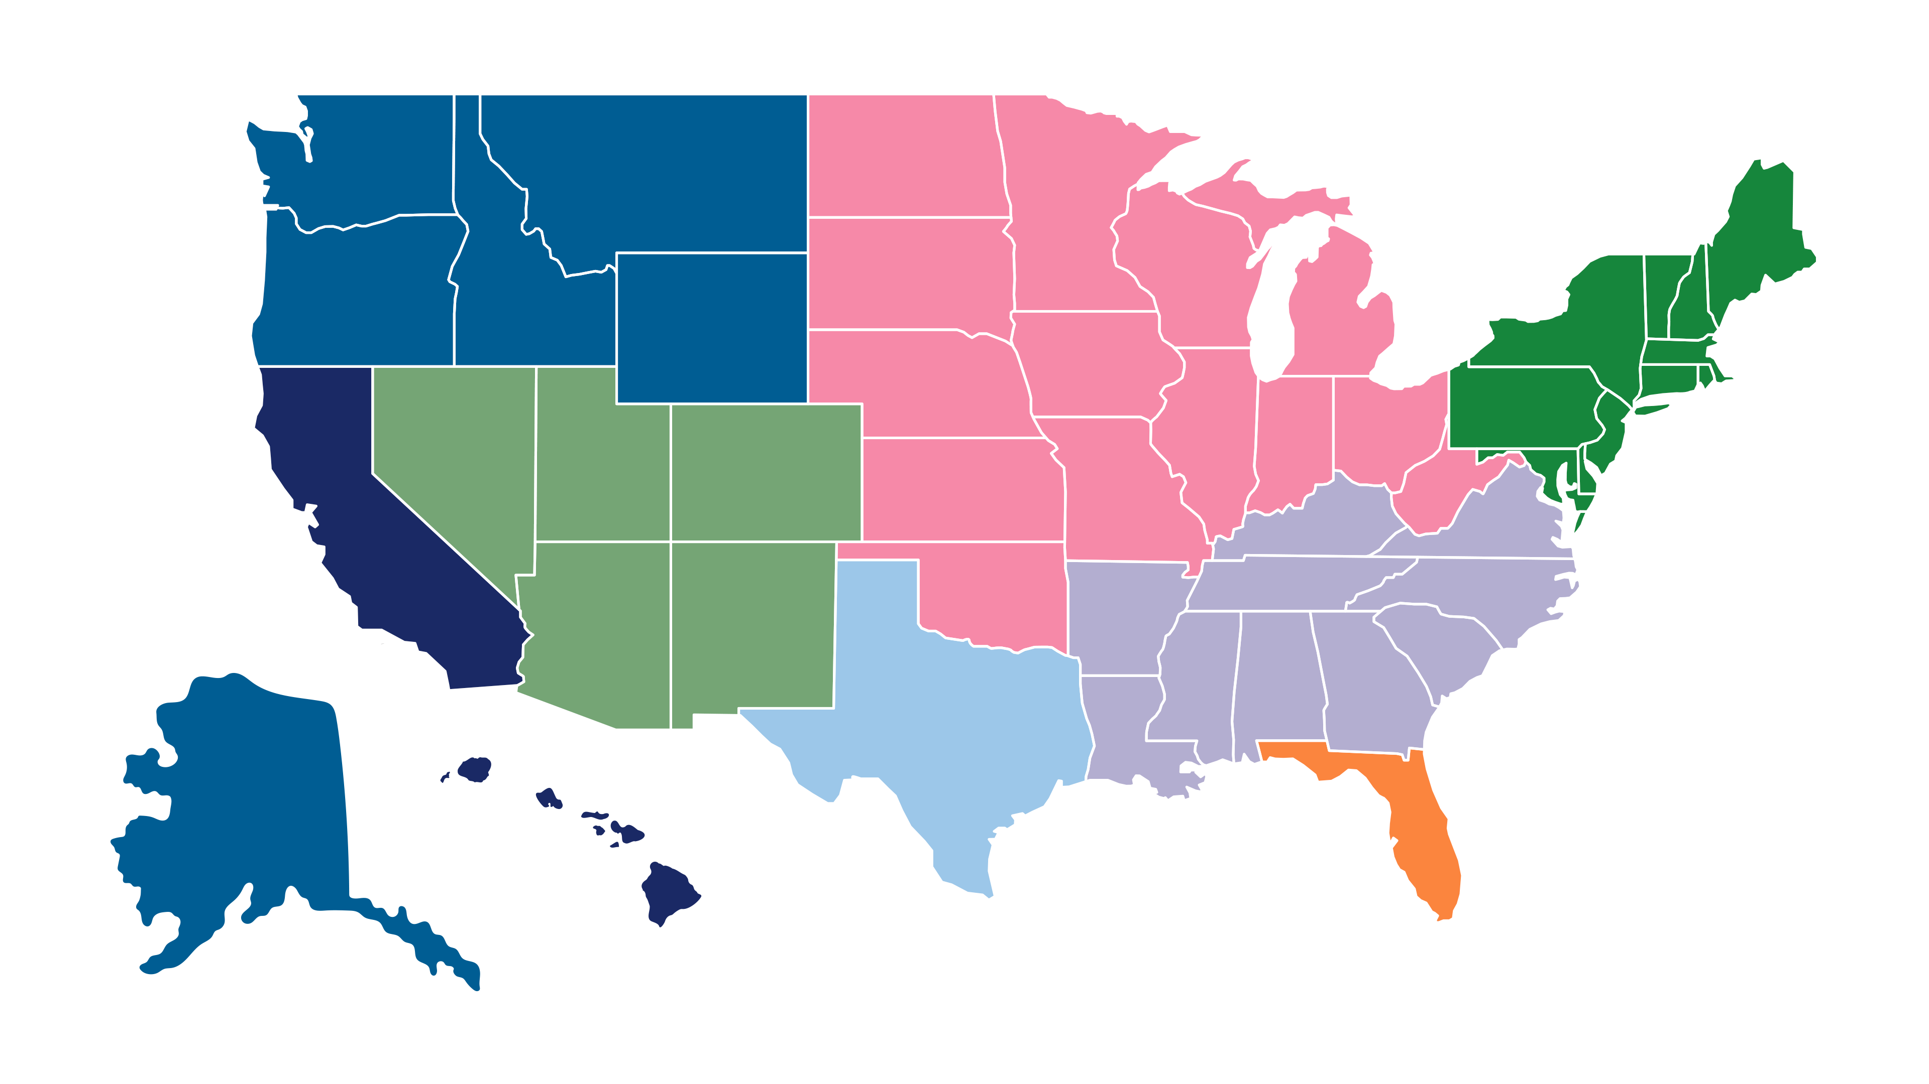
2023 FELLOWS COMPETITION
CAL-ABOTA
FLABOTA
Midwest
Northeast
REGIONS
Pacific Northwest
Southwest
SEABOTA
TEX-ABOTA
THE ABOTA FOUNDATION
FELLOWS PROGRAM

Slide 25
2023 FELLOWS COMPETITION
Regionals
Jan 26 – Aug 19
Playoffs
Aug 19 – Sep 2
Final Four
Sep 2 – Sep 16
Championship
Sep 16 – Oct 6
CAL-ABOTA
Midwest
TEX-ABOTA
Southwest
FLABOTA
Northeast
SEABOTA
Pacific Northwest
CAL-ABOTA
FLABOTA
Midwest
Northeast
Pacific Northwest
Southwest
SEABOTA
TEX-ABOTA
THE ABOTA FOUNDATION
FELLOWS PROGRAM

Slide 26
v
THE ABOTA FOUNDATION
PARTNERSHIPS
PARTNERSHIP OPPORTUNITIES
The Foundation seeks to engage in partnerships with like-minded organizations to fund its larger projects.
Contact foundation@abota.org to learn more.

Slide 27
The contributions of time, talent, and resources are what enable the work to continue.

